Slide 1
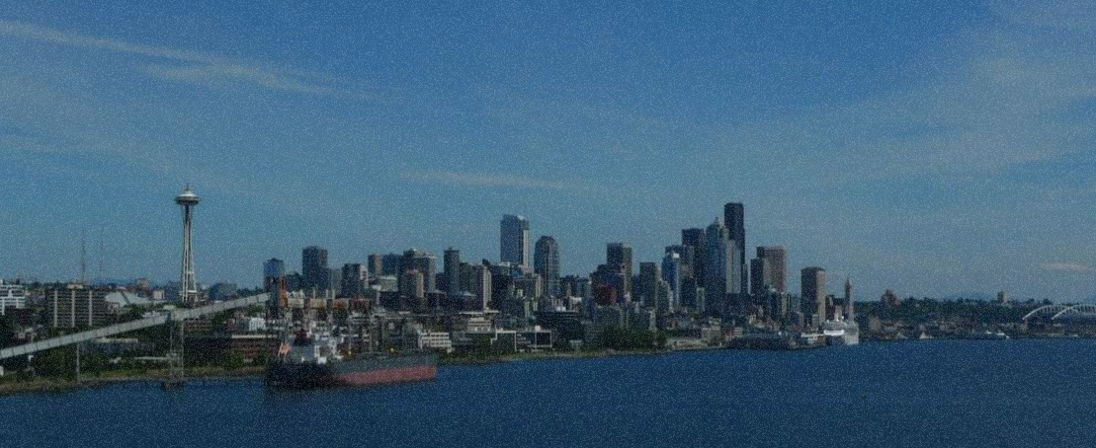
Seattle
Making the Most of Your First Port

Slide 2
Seattle
With Kodiak West Travel

Slide 3
Seattle Weather
Heavy rain in January to May and October to December
Average yearly precipitation is 37 inches
Average temperature in July and August is 75 degrees

Slide 4
Visit Seattle Before or After Your Cruise to Alaska!
Kodiak West Travel Can Help You Develop Your Itinerary

Slide 5

Although cruises to Alaska are held during summer months, a visit to Seattle in summer is no guarantee of sunshine! Keep your favorite umbrella handy!

Slide 6
Day One Sample Itinerary
Get an early start!
Pike Place Market for breakfast and shopping
Olympic Sculpture Park and a stroll along the waterfront
Mid-afternoon
The Seattle Aquarium
Evening
Seattle Underground Tour
Pike Place Market for dinner

Slide 7
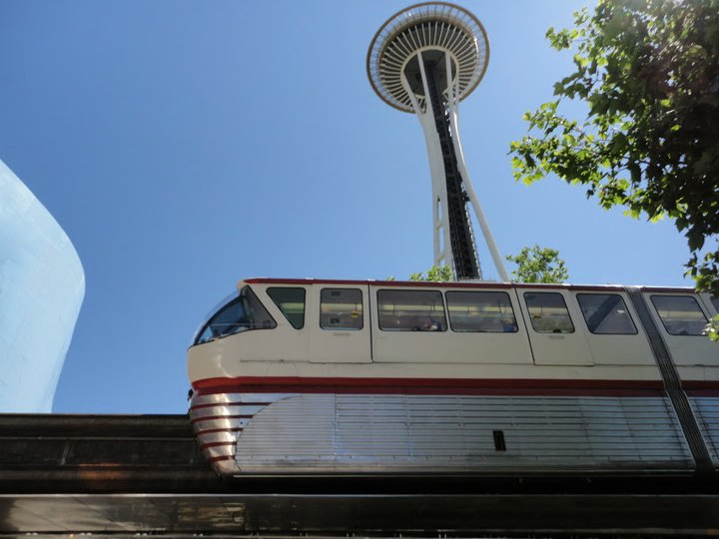
Day Two Sample Itinerary
Pike Place Market
Breakfast here again and visit the places you loved or missed
Experience Music Project and Science Fiction Museum
The Space Needle
Seattle’s iconic and most famous landmark

Slide 8
And if you can spare one more day…

Slide 9
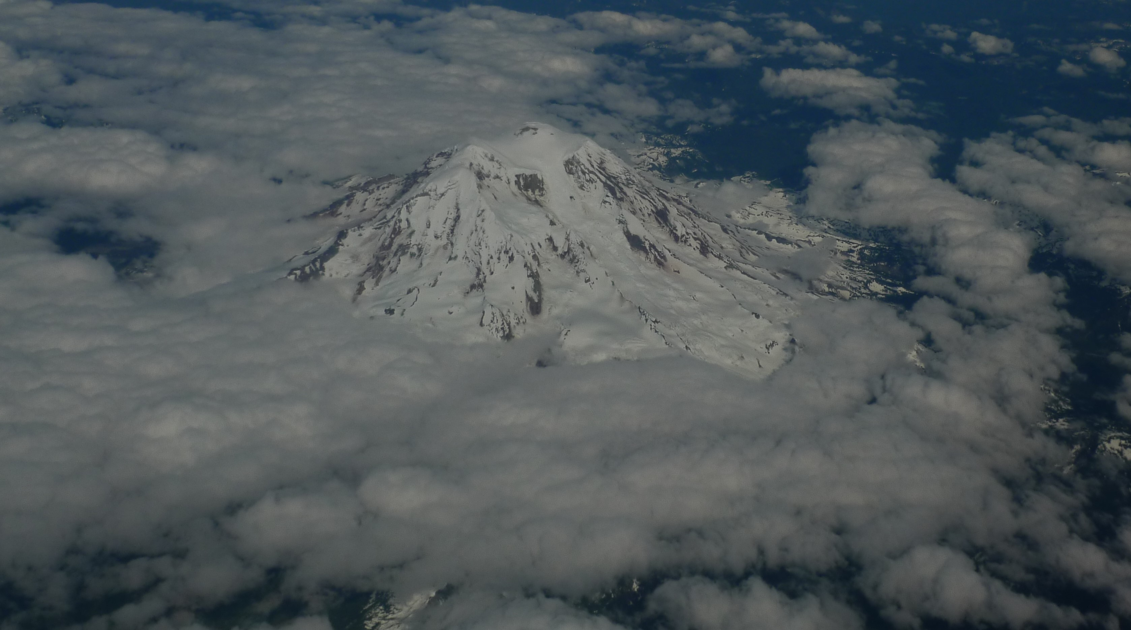
Visit Mt. Rainier National Park!

